Slide 1

Art of Conversation

Slide 2
The Art of Conversation Ask your neighbor….
Ask your neighbor what was the name of the last movie they saw
Take the time to really listen (Pause) You may even ask them to repeat.
Acknowledge your partner by restating what they just said (paraphrase) and then asking another question (probe).
Possible question starters:
*Was ____ as good as the trailers made it look?
*Who was your favorite actor in ________?
*?????????????????????????

Slide 3

Talking Sticks The Art of Conversation
1. Each person place his/her pencil (or pen) on the table.
2. Take turns making a statement or a comment
(to take a turn pick up your pen). Others are silent and listening!
3. After you comment, keep your pen
4. After everyone has commented* (all pencils are picked up) put them back on the table, and repeat the process, adding new ideas
Sample comment starters:
“I agree with…”
“I agree with Joe but I would add…” or “I would change…”
“I’m interested in hearing more about…”
“I’m still confused about…”
“Just like Joe I think…”
“I disagree with Joe because I think that…”
“One thing I thought about is…
*Everyone comments!
If you have nothing new to add you may comment on what someone else has said.
Notes:
Quickly share out what to do next and guide students data collection

Slide 4
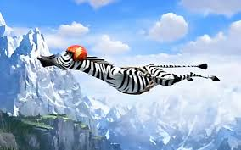
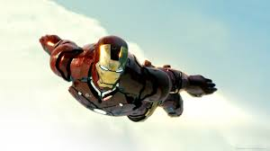
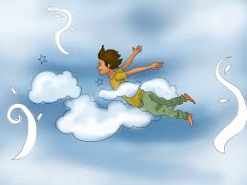

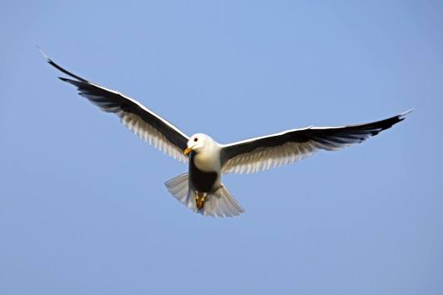
The Art of Conversation Use your talking Sticks to share
What would you do
if you could fly

Slide 5
Use the talking sticks protocol
To discuss what you would do if ……..
You were invisible

Slide 6

Find your Birthday Partner
Please remember to:
Pause (wait)
Paraphrase (repeat back to your partner what you heard, but in your own words)
Probe (ask another question)
Ask: What was the most exciting thing you did this summer.

Slide 7
Use your group norms
Ask your neighbor:
What is your super power?

Slide 8

Find your music partner
Ask:
What is the objective of todays Investigation?

Slide 9
The Art of Conversation Using your Norms: Discuss…….
Please remember to:
Pause (wait)
Paraphrase (repeat back to your partner what you heard, but in your own words)
Probe (ask another question)
What is Biology?

